Slide 1
Wassmer Tract Preliminary Improvement Plans
Multi-Use Trail Interconnection
and Community Improvement Plans

Slide 2
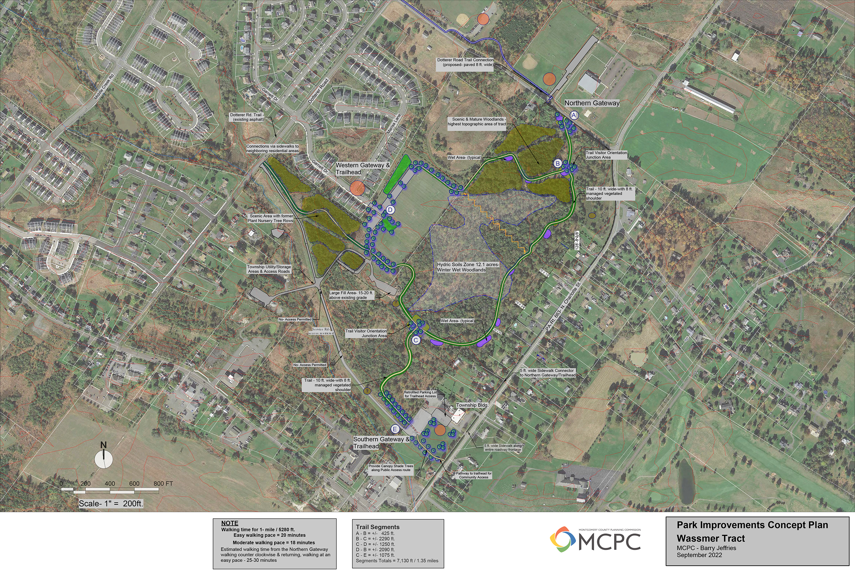
North
Notes:
Original MCPC Plan
Orientation North to the Top
Layout based on the original Wassmer Tract Development Plans
Paths followed roadway corridor previously cleared by the developer of the tract.

Slide 3
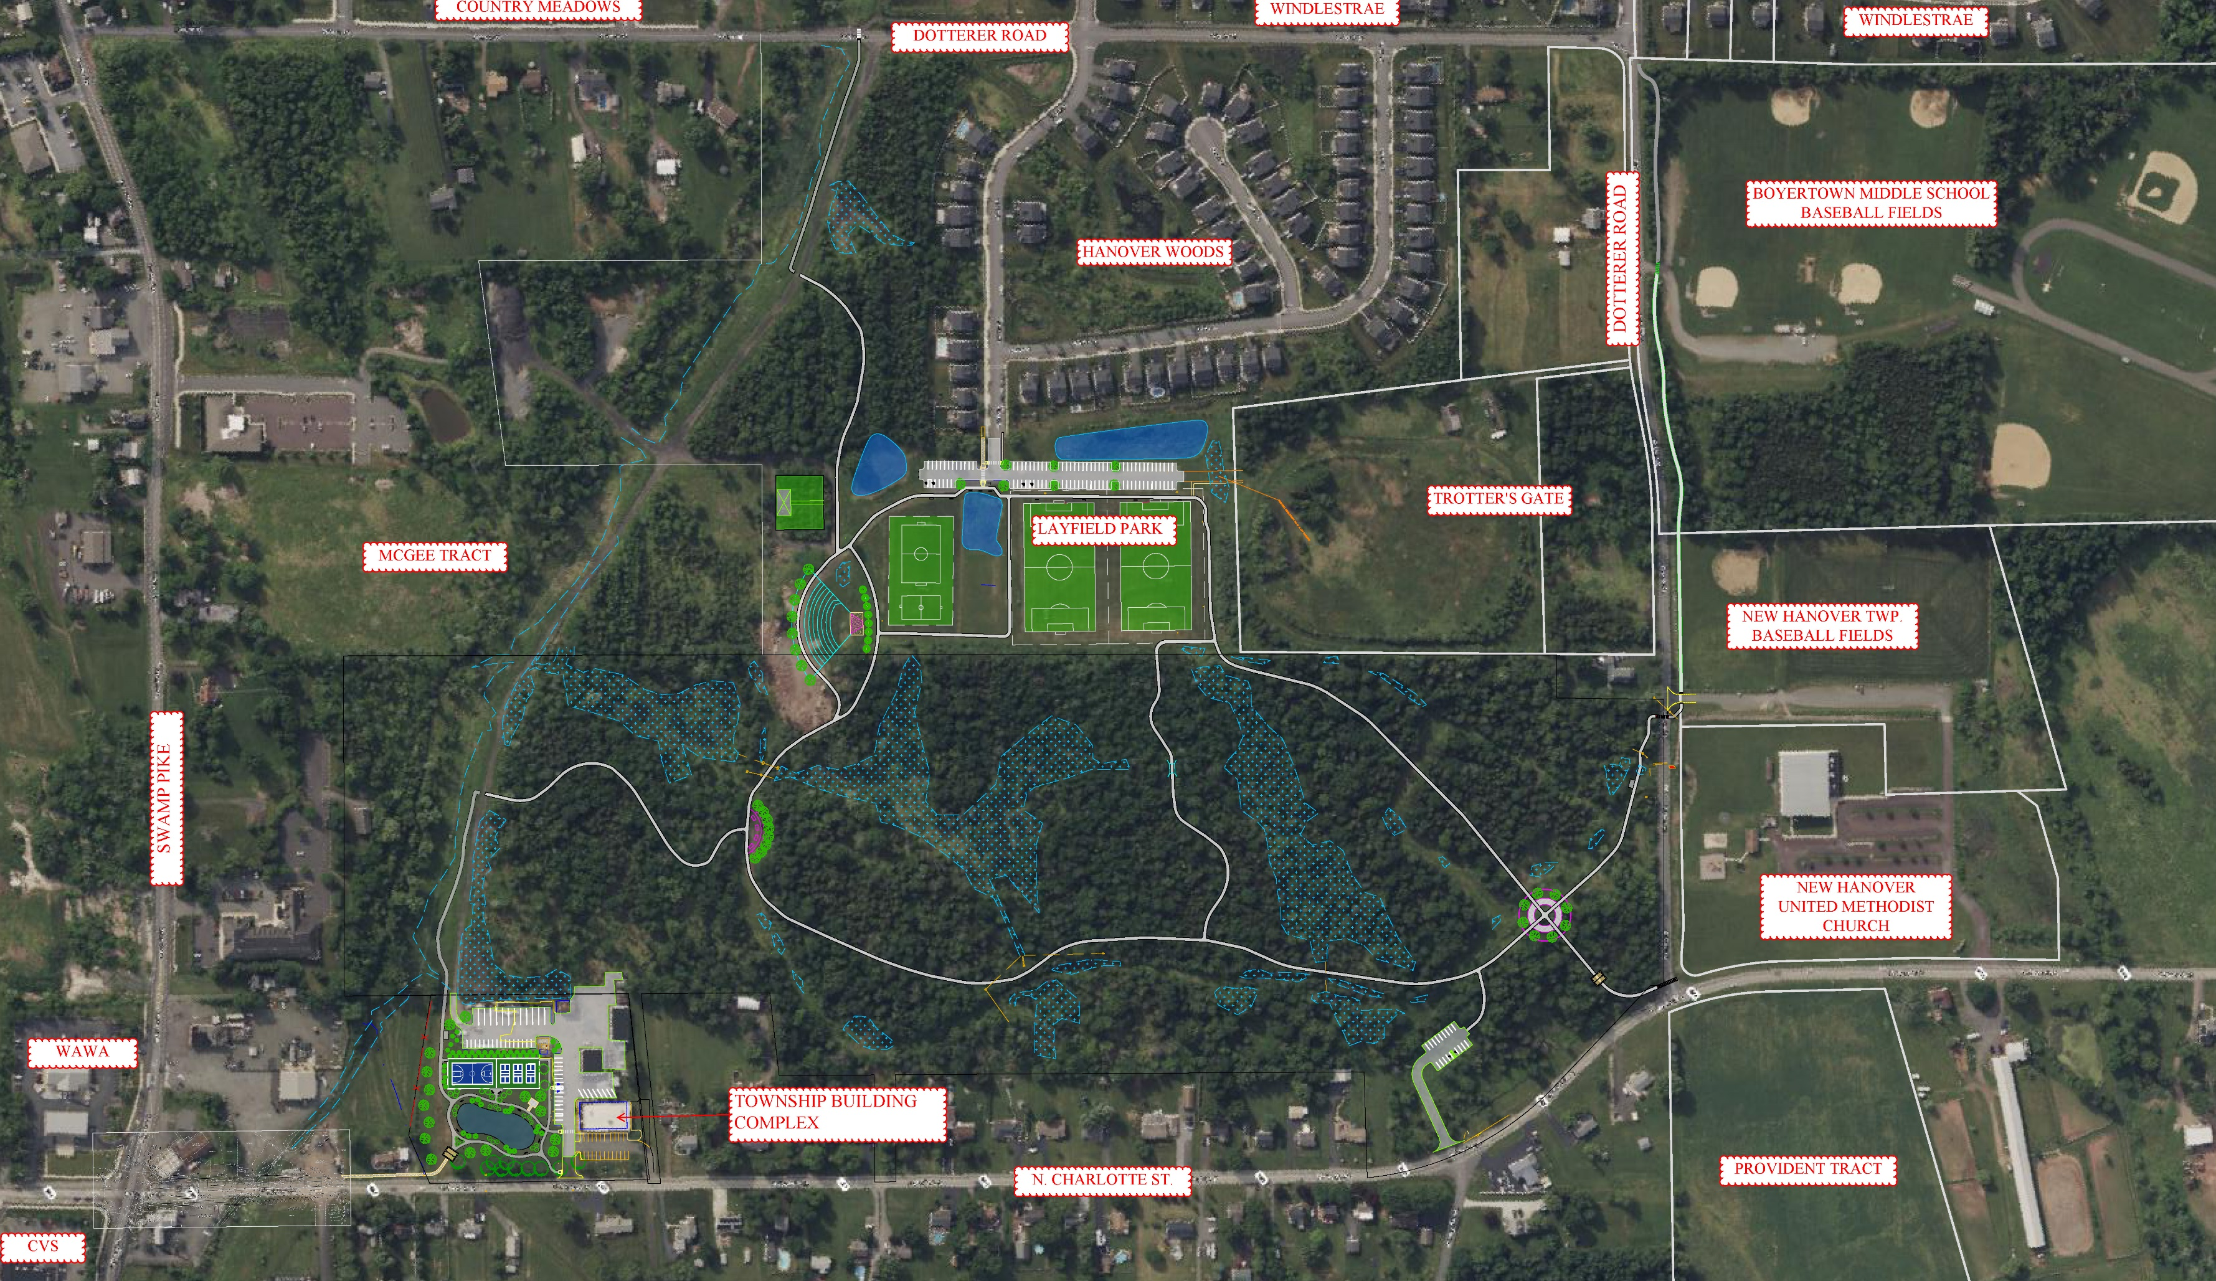
North
OVERALL LAYOUT PLAN
Notes:
Revised Overall Layout Plan
Orientation to Site – North to the top right of view.
North Charlotte Street, Twp Building, Swamp Pike Wawa, Dotterer Road, Windlestrae, Hanover Woods, NH UMC, Provident Tract
Plan Changes
Updated Wetland Delineation
Elimination of Boardwalk Concept
Relocation Away from Previously Cleared Roadway Corridor in some areas
Path Along Service Drive

Slide 4
Township Building Complex Improvements
Community Space Improvements
Trailhead Facilities
Entrance Amenity
Parking Area Improvements
Bike Repair Station
Interconnection to Existing Trails
Opportunities for Future Connections
Potential Court Games Space
Pickleball/Basketball/Tennis
Public Works Space Screening
Wet Pond / Stormwater Feature
Picnic Shelter
Park Benches
Pond Fountain
Landscape Improvements
Reconfigured Township Parking Area
Defined Public Work Parking
Opportunities for Expansion
Salt Shed Building
Additional Parking for Twp. Events
Completion Administration Building Parking Improvements
Notes:
Community Space Improvement
Trailhead Facilities
Court Games Concept
Wet Pond
Parking Improvements

Slide 5
Township Building Complex Improvements
Park Entrance Feature
Bicycle Repair Station and Bike Racks

Slide 6
Township Building Complex Improvements
Community Oriented Court Games
Wet Pond / Stormwater BMP

Slide 7
Township Building Complex Improvements
Community Space Improvements
Trailhead Facilities
Entrance Amenity
Parking Area Improvements
Bike Repair Station
Interconnection to Existing Trails
Opportunities for Future Connections
Potential Court Games Space
Pickleball/Basketball/Tennis
Public Works Space Screening
Wet Pond / Stormwater Feature
Picnic Shelter
Park Benches
Pond Fountain
Landscape Improvements
Reconfigured Township Parking Area
Defined Public Work Parking
Opportunities for Expansion
Salt Shed Building
Additional Parking for Twp. Events
Completion Administration Building Parking Improvements
Notes:
Community Space Improvement
Trailhead Facilities
Court Games Concept
Wet Pond
Parking Improvements

Slide 8
Wassmer Tract Multi-Use Trail Interconnection
Access to Wassmer Tract - Main Trail Segments
Relocated Trail Segment
Separated from Service Road
Wetland Preservation
Layout Significantly Changed due to updated Wetland Delineation
Relocated Path away from existing cleared access
Relocated Path away from N. Charlotte St. Properties
Community Amenity Improvements
Veterans Memorial Tree Park
Visitor Orientation Junction Area
Reflection Wall and Seating Area
Memorial Tree Grove
Wildlife Habitat Kiosk Area
Notes:
Relocation of the Path to opposite side of Service Drive to avoid wetlands that are behind Public Works Area
Followed terrain up to first intersection
Recommending Visitor Orientation Junction configured as a rest and reflection area.
Small knee wall with seating area, possible veteran's monument features.
Behind the wall is a memorial tree grove that residents would be able donate towards to honor either a veteran or just family member if we don’t configure as a veteran monument.
Wildlife Habitat Kiosks – Proposing 10-12 throughout trail system.

Slide 9
Multi-Use Trail Improvements
Veterans Memorial Wall
Wildlife Habitat Kiosks

Slide 10
Wassmer Tract Multi-Use Trail Interconnection
Access to Wassmer Tract - Main Trail Segments
Wetland Preservation
Layout Significantly Changed due to updated Wetland Delineation
Relocated Path away from existing cleared access
Relocated Path away from N. Charlotte St. Properties
Community Amenity Improvements
Pedestrian Foot Bridge
Sensitive Area Construction
Avoid Wetlands and Mature Trees
Vegetated Stormwater Swales
Wildlife Habitat Kiosk Areas
Notes:
Revised layout due to wetlands
Relocated away from properties along North Charlotte Street.
Small Pedestrian Bridge over drainage ditch.
Community Kiosks provide at main intersections with mapping of site, location information, other information.

Slide 11
Multi-Use Trail Improvements
Pedestrian Foot Bridge
Community Kiosks

Slide 12
Wassmer Tract Multi-Use Trail Interconnection
Northern Gateway and Trailhead Improvements
Relocated Access to Dotterer Road
Location Adjusted to avoid new wetlands
Interconnection to New Trail to Windlestrae
Access to Parking Facilities at Township Baseball Fields
Mid-Block Crosswalk Improvements
Bike Repair Station and Bike Rack
Main Trail Connection Point
Visitor Orientation Junction Area
Rest Area with Seating
Potential Community Supported Sculpture Garden
Direction Signage and Wildlife Habitat Kiosks
Trailhead Parking Area at Swamp Picnic Road
20-Space Parking Area
Direction Signage and Community Kiosk
Maintenance Access Point to Northern Portion of Park
Park Benches and Bike Racks
Connection to Future Development Area
Notes:
Norther Gateway and Trailhead improvements at Dotterer Road access across from NH Township Ball field parking area.
Utilizes the existing parking facilities and provides a crossing to multi-use trail.
Possible new entrance feature sign to highlight park entrance.
Main Trail Connection Point relocated slightly due to some isolated wetlands.
2nd Visitor Orientation Junction Area, with Community Supported Sculpture Garden and seating area.
New Trailhead Parking Area at Swamp Picnic Road, additional access point to Swamp Picnic Road residents.
Another opportunity for park entrance signage and Community Information Kiosks.
Connection to future development area to the Northeast along N. Charlotte Street and the pending development connections from Provident Tract, Hanover Meadows and others.

Slide 13
Multi-Use Trail Improvements
Community Supported
Sculpture Garden Concept
Dotterer Road/Swamp Picnic Road
Entrance Signage and Site Mapping

Slide 14
Layfield Park Improvements
Western Gateway and Trailhead Improvements
Completion of Hanover Woods Entry
Extension of Pedestrian Access
Parking Area Enhancements
New Drop Area and Parking Area
Connection To Trotter’s Gate
Community Improvements
Amphitheater with Band Shelter
Repurposing of Existing Stockpiles
Centrally located near community
Orientated away from residential lots.
Community Garden
Repurposed Nursery Facility
Small shed with fenced in garden space
Operated by Community Organizations
Multi-Use Trail Connections
Opportunities to increase ADA Access to fields
Park Benches and Bike Racks
Reconfiguration of Existing Stormwater BMPs
Notes:
Western Gateway and Trailhead Improvements at the existing entrance from Hanover Woods
Extension/completion of pedestrian facilities, ADA cross-walks, Drop off area and additional parking facilities.
Improvements to the existing parking areas, with possible interconnection from Trotter’s Gate development and the previously agreed upon improvements.
Community Improvements including Amphitheater, Band Shelter, Sledding Hill and the cleanup of the Township’s Storage area.
Possible Community Garden in old nursery yard area.
Additional connection points to the multi-use trail system allows for some ADA access improvements to the existing play fields.
Park benches for children waiting to be picked up, spectators and trail users and bike racks to allow residents to ride their bike to the park and then walk around park.
Reconfiguration of the existing stormwater BMPs to improve functioning and to reduce costs to support new improvements.

Slide 15
Layfield Park Improvements
Amphitheater with Band Shelter and Sledding Hill
Community Garden

Slide 16
Layfield Park Improvements
Western Gateway and Trailhead Improvements
Completion of Hanover Woods Entry
Extension of Pedestrian Access
Parking Area Enhancements
New Drop Area and Parking Area
Connection To Trotter’s Gate
Community Improvements
Amphitheater with Band Shelter
Repurposing of Existing Stockpiles
Centrally located near community
Orientated away from residential lots.
Community Garden
Repurposed Nursery Facility
Small shed with fenced in garden space
Operated by Community Organizations
Multi-Use Trail Connections
Opportunities to increase ADA Access to fields
Park Benches and Bike Racks
Reconfiguration of Existing Stormwater BMPs

Slide 17
Wassmer Tract Multi-Use Trail Interconnection
Connection to Dotterer Road
Connection to Trail System along Dotterer Road
Mid-block Crosswalk Improvements
Possible Traffic Calming Improvements
Service Drive Drainage Improvements
Separated Trail from Service Drive
Relocated Path to avoid wetlands
Scenic Trail Area through former Nursery Tree Rows
Notes:
Connection to second Dotterer Road entrance along Service Drive.
Midblock crossing at entrance to connect to the existing Dotterer Road trail that connects Country Meadows, Montgomery View and Windlestrae.
Some minor Service Drive drainage improvements expected with the new trail connection.
Relocated to avoid wetlands and other environmentally conditions.
Trail through existing nursery tree rows.

Slide 18
North
OVERALL LAYOUT PLAN
Notes:
Additional misc. items
Mile Markers
No exercise stations
Composite Material Benches along trails.
Trash collection at trailheads and community improvement areas, but not throughout trail system.
Stormwater will be accommodated with vegetated swales with underdrains and filter media along paths, the wet pond at the Township Complex, and some modifications to the facilities at Layfield Park.
Questions/Comments

